Slide 1
Modified Grey Wolf Optimization to Solve Traveling Salesman Problem
Dibbendu Singha Sopto¹, Safial Islam Ayon¹, M. A. H. Akhand¹ and N. Siddique²
¹Dept. of CSE, Khulna University of Engineering & Technology (KUET), Bangladesh
²School of Computing, Engineering and Intelligent Systems, Ulster University, UK
International Conference on Innovation in Engineering and Technology (ICIET)
December 27-28, 2018, Dhaka, Bangladesh

Slide 2
Outline
Grey Wolf in Nature
Grey Wolf Optimization (GWO) Algorithm
Modified GWO for Traveling Salesman Problem (TSP)
Result and Comparison
Conclusion

Slide 3
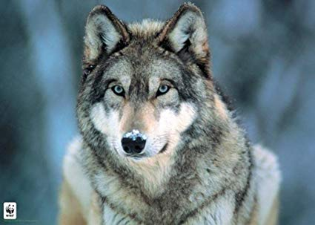
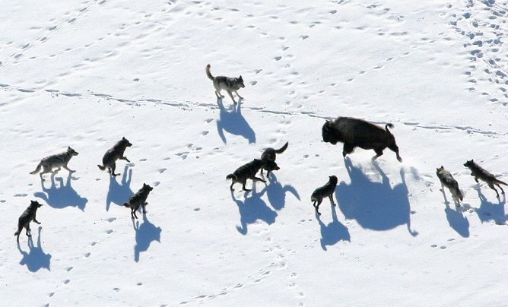
Introduction
Grey wolf maintain a hierarchy of their society.
Grey Wolf Optimization (GWO) algorithm is a population-based meta-heuristics algorithm inspired by the hunting and social behavior of the grey wolf pack.
Standard GWO is developed for numerical or function optimization.
This study investigates a new technique to solve TSP using GWO.

Slide 4
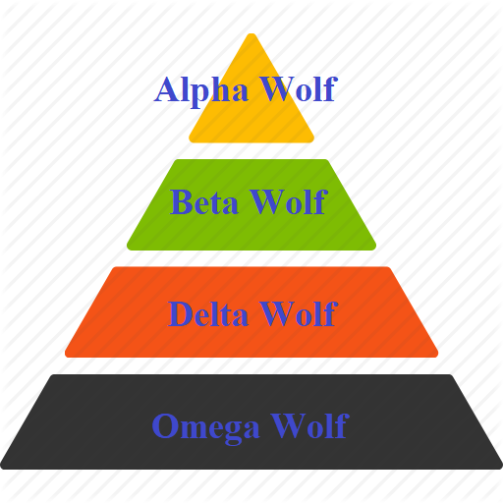
Hierarchy of Grey Wolf
The leader of the folks of a grey wolf is called Alpha wolf.
The wolf right next to the hierarchy is a Beta wolf.
Then there is Delta wolf is in the hierarchy.
The rests are called Omega wolves.

Slide 5
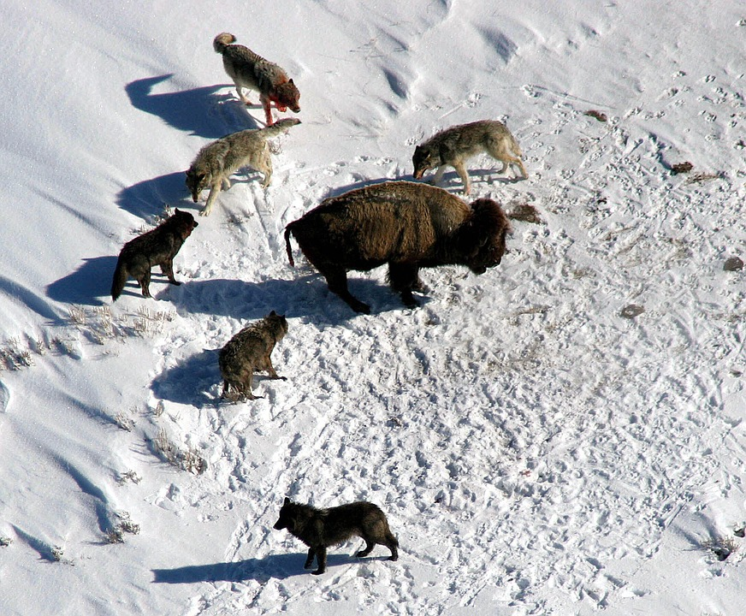
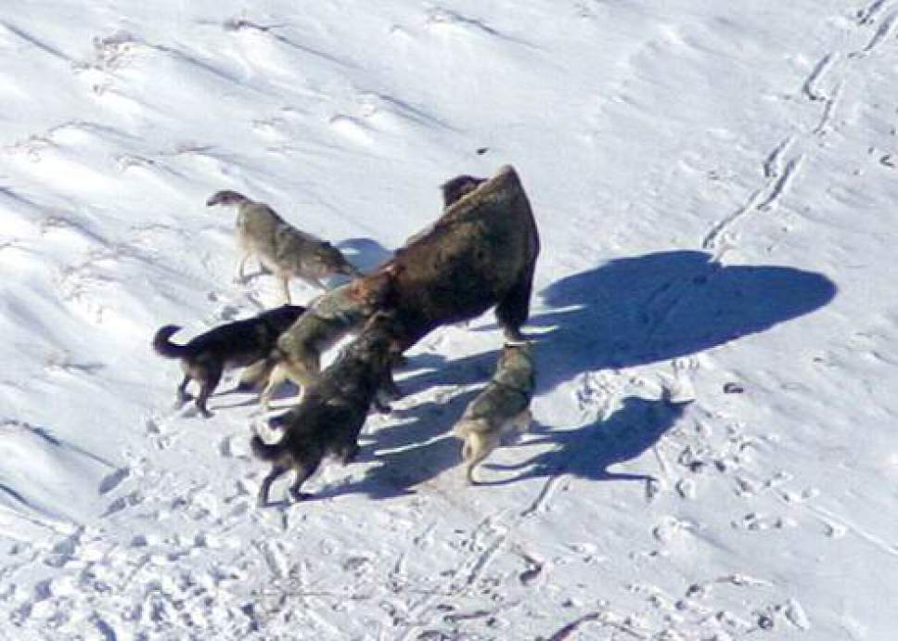
Hunting Behavior
Main phases of Grey Wolf hunting are: Tracking, Pursuing, and Attack

Slide 6
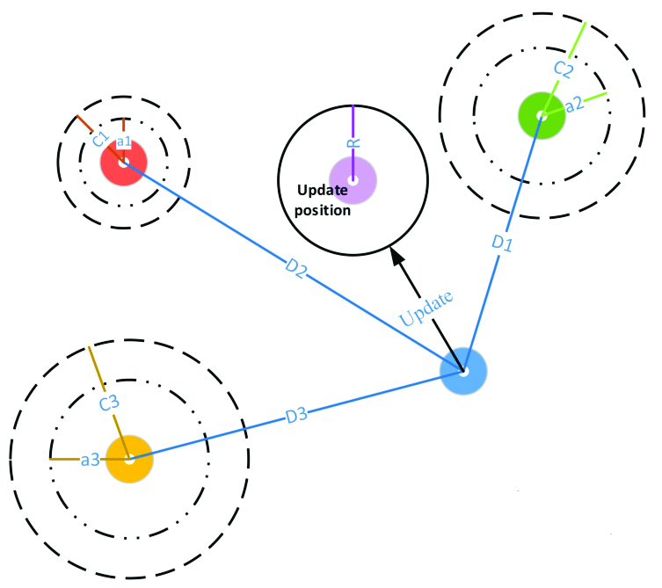
GWO for FO: Position Change
D1 = Distance from Alpha wolf; D2 = Distance from Beta wolf;
D3 = Distance from Delta wolf; a and C are Parameter Vector.

Slide 7
GWO for FO: Position Update
In GWO, each wolf (X) update its position based on Alpha (X_{α}), Beta (X_{β}), and Delta (X_{δ}) Wolfs.
Position updated Equation:
Dα = |C₁.Xα - X|, D_{β} = |C₂.X_{β} - X|, D_{δ =} |C₃.X_{δ} - X|
X₁ = Xα - A₁.(Dα) , X₂ = X_{β} - A₂.(D_{β}), X₃ = X_{δ} - A₃.(D_{δ})
X_{(t+1) =} ( X₁ + X₂ + X₃ ) / 3
Dα, Dβ, Dδ = Velocity gained from Alpha, Beta and Delta wolfs
A and C are coefficient vectors

Slide 8
GWO for TSP
GWO found effective for solving engineering optimization problem.
For solving TSP, every particle (i.e., wolf) is considered as a TSP solution i.e., complete tour.
The solution updating parameter is termed as Swap Sequence (SS) and Swap Operators (SO).
A SS may define as SS= (SO₁, SO₂, SO₃... So_{n}) . A SO indicates two positions in the TSP solution that might be swap to get a new Solution.

Slide 9
GWO for TSP: Swap Operation
Suppose a tour of five cities is S= (l, 5, 3, 2, 4), and Swap Operator SO(1, 2), the new tour S’ is:
S’ = S + SO(1, 2)
= (1, 5, 3, 2, 4) + SO(1, 2)
= (5, 1, 3, 2, 4)
Here, ‘+’ means apply the SO in the solution.
The Swap Sequence may also get from solutions S1 and S2 in the following equation.
SS = S2 – S1 = (SO1, SO2, SO3, …, SOn)
1
1
5
5
2
2
4
4
3
3

Slide 10
GWO for TSP: Update though Partial Search
In Partial Search (PS), apply SO of SS and final output is a portion or full SS which give best tour.
Suppose a solution is S = (1 – 3 – 2 – 5 – 4) and SS = {SO (2,3), SO (1,2), SO (4,5)}.
Apply Swap Sequence | New Solution | Function Value
(1 – 3 – 2 – 5 – 4) + SO (2,3) | (1 – 2 – 3 – 5 – 4) | f(x) = 20.45
(1 – 2 – 3 – 5 – 4) + SO (1,2) | (2 – 1 – 3 – 5 – 4) | f(x) = 19.45
(2 – 1 – 3 – 5 – 4) + SO (4,5) | (2 – 1 – 3 – 4 – 5) | f(x) = 21.45
In PS, solution with the lowest value 19.45 for (2 – 1 – 3 – 5 – 4)
is considered as the updated solution.

Slide 11
GWO for TSP: Equation to update Solution
D = c1. |Xα- Xt| + c2. |Xβ – Xt| + c3. |Xδ – Xt| (1)
X(t+1) = Xt +D (2)
Here,
Xα, Xβ and Xδ are the TSP tours of Alpha, Beta and Delta wolfs
c1, c2, c3 = Random percentage;
D = Swap Sequence = SO1, SO2, … ,SOn;

Slide 12
GWO for TSP: Generate Swap Sequence
Suppose,
Xt = Xα =
Xβ = Xδ =
3
7
6
9
2
4
10
5
8
1
10
7
6
9
2
4
3
5
8
1
4
10
8
5
1
2
3
7
9
6
9
6
7
3
2
4
10
5
8
1
|Xα - Xt|
-
10
7
6
9
2
4
3
5
8
1
3
7
6
9
2
4
10
5
8
1
(1,7)
|Xβ - Xt|
-
4
10
8
5
1
2
3
7
9
6
3
7
6
9
2
4
10
5
8
1
(1,7), (2,7), (3,9), (4,8), (5,10), (6,10), (7,10), (8,10)
|Xδ - Xt|
-
9
6
7
3
2
4
10
5
8
1
3
7
6
9
2
4
10
5
8
1
(1,4), (2,3)

Slide 13
GWO for TSP: Calculate Swap Operators
D = c1. |Xα- Xt| + c2. |Xβ – Xt| + c3. |Xδ – Xt|
D = c1 (1,7) + c2 {(1,7), (2,7), (3,9), (4,8), (5,10), (6,10), (7,10), (8,10)} + c3 {(1,4),(2,3)}
Suppose c1 = rand()= 0.1, c2 = rand()= 0.3 and c3 = rand()= 0.5
D = (0.1{(1,7)} + 0.3{(1,7), (2,7), (3,9), (4,8), (5,10), (6,10), (7,10), (8,10)} + 0.5{(1,4),(2,3)})
D = (1,7),(2,7),(3,9),(1,4)

Slide 14
GWO for TSP : Solution Update
3
3
3
3
3
3
9
9
9
9
9
7
9
7
7
7
7
7
2
2
2
2
2
2
10
10
10
10
10
X(t+1) = Xt +D
Xt =
D = (1,7), (2,7), (3,9), (1,4)
10
1
1
1
1
1
6
1
6
6
6
6
6
8
8
8
8
5
8
5
8
5
5
5
5
3
7
6
9
2
4
10
5
8
1
4
4
4
4
4
4
3
7
6
9
2
4
10
5
8
1
∫(x) 51.36
(1,7)
10
7
6
9
2
4
3
5
8
1
∫(x) 44.31
(2,7)
∫(x) 44.06
10
∫(x) 44.06
10
3
3
6
6
9
9
2
2
4
4
7
7
5
5
8
8
1
1
(3,9)
10
3
8
9
2
4
7
5
6
1
∫(x) 44.50
(1,4)
9
3
8
10
2
4
7
5
6
1
∫(x) 47.87

Slide 15
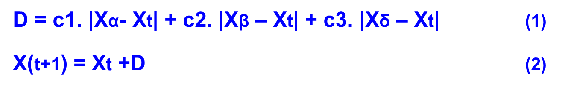
GWO for TSP: Algorithm
Step 1: Initializing the population,
Step 2: For each particle Xt in the population
a. Find out all the Swap Sequence using Eq. (1)
b. Calculate the Basic Swap Sequence of the generated SS
c. Update Solution Xt using Partial Search manner using Eq. (2)
d. Update the best hunt agents in each iteration if there is any superior solution than the current agents.
Step 3: Jump to Step 2 until a termination criterion is found.
Step 4: After all the iterations and operations the best solution (Xn) will be considered as the best result.

Slide 16
Comparison of Average result for 20 runs
Problem | GA | ACO | PSM | GWO
Burma14 | 31.83 | 31.21 | 30.89 | 30.87
Ulysses16 | 74.79 | 77.13 | 74.2 | 73.99
Gr17 | 2458.36 | 2332.58 | 2375.39 | 2332.58
Gr21 | 3033.82 | 2954.58 | 2838.22 | 2714.65
Ulysses22 | 79.62 | 86.81 | 76.68 | 76.08
Gr24 | 1402.01 | 1267.13 | 1372.57 | 1289.23
Fri26 | 689.49 | 646.48 | 675.24 | 644.67
Bays29 | 9981.49 | 9964.78 | 9917.59 | 9219.40
Hk48 | 16033.31 | 12731.07 | 13870.94 | 12117.05
Eil51 | 592.3 | 504.83 | 474.58 | 463.29
Berlin52 | 10413.61 | 8088.95 | 8865.08 | 8289.11
Population size: 100 and number of generation: 500.

Slide 17
Comparison of Best result for 20 runs
Problem | GA | ACO | PSM | GWO
Burma14 | 30.87 | 31.21 | 30.87 | 30.87
Ulysses16 | 74.0 | 77.13 | 73.99 | 73.99
Gr17 | 2332.58 | 2332.58 | 2332.58 | 2332.58
Gr21 | 2672.27 | 2949.81 | 2672.27 | 2672.27
Ulysses22 | 76.09 | 86.74 | 75.51 | 75.51
Gr24 | 1249.82 | 1267.13 | 1249.82 | 1249.82
Fri26 | 647.78 | 646.48 | 635.58 | 635.58
Bays29 | 9336.82 | 9964.78 | 9076.98 | 9076.98
Hk48 | 14040.66 | 12699.86 | 12239.3 | 11183.46
Eil51 | 524.18 | 499.92 | 438.7 | 455.24
Berlin52 | 9184.19 | 8046.06 | 8109.91 | 8048.91
Population size: 100 and number of generation: 500.

Slide 18
Analysis: Variation Effect of Population on Eil51

Slide 19
Analysis: Effect of Total Iteration on Eil51

Slide 20
Conclusion
GWO is modified to solve TSP which is a combinatorial optimization task.
Swap Sequence and Swap Operators based operation is developed for TSP.
The proposed GWO for TSP showed better performance in most of the cases compared to GA, ACO and PSM.

Slide 21
Thanks for your attention
Question and Answer

